Slide 1
Welcome to NHO
Katarina Sætersdal

Slide 2

This is NHO
Norway’s largest stake-holder organisation for businesses
Ca 25,000 members and ca 560,000 employees in member companies
photo: Olav Heggø
Notes:
The Confederation of Norwegian Enterprise (NHO) is Norway’s largest stakeholder organisation for businesses in Norway.
24,000 companies are members of NHO and 560,000 people are employed in NHO’s member companies. At NHO we acquire new members all the time and this strengthens our capacity for influence in representing the companies’ interests.
NHO has 21 national sector federations, 15 regional offices and an office in Brussels.

Slide 3


Part of a larger
community
NHO Finnmark
NHO Troms
NHO Nordland
NHO Møre and Romsdal
NHO Trøndelag
NHO Sogn and Fjordane
NHO Innlandet
NHO Hordaland
NHO Buskerud
NHO Oslo and Akershus
NHO Rogaland
NHO Østfold
NHO Agder
NHO Vestfold
NHO Telemark
Notes:
NHO’s 15 regional offices assist NHO members throughout Norway, from Kristiansand in the south to Vadsø in the north. We also have our own office in Brussels.
The regional offices work with political issues of importance for industry and working life issues, as well as providing advice and guidance for members.
You can find the regional office closest to you at nho.no/regionforeninger.

Slide 4



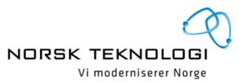













Our national sector federations

Slide 5

Employers' association
Wage settlement
Determines the frameworks for wage development in Norway
Ensures predictable wage and working conditions
Competitive development in relation to trade partners
photo: Scanpix
Notes:
NHO carries out central wage settlements with employee organisations on behalf of the member companies. We also provide assistance in local wage negotiations. In this manner NHO participates in determining the terms for wage development in Norway. Our objective is to ensure a wage and price increase that is not greater than the countries with which we trade, schemes for more flexible working hours, and a competitive tax and contributions policy.

Slide 6

Political work
A solid foundation for value creation
Working life for the future
Research and innovation
Quality in education
Well-functioning public sector
Sustainable energy and climate policy
Good transport solutions
Global competitiveness
Foto: Hans Fredrik Asbjørnsen

Slide 7
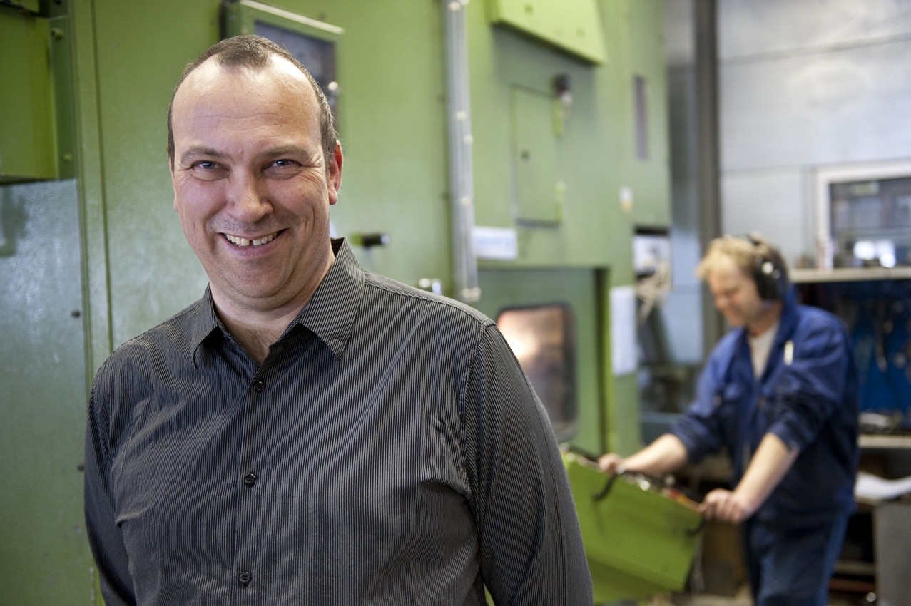
Membership benefits with NHO
Expert assistance with working life issues
NHO Occupational Pension
Less costly legal services
Courses and conferences
photo: Olav Heggø
Notes:
Expert assistance with working life issues: As a member, NHO will assist you with matters pertaining to relations between the company and employees. NHO’s solicitors give advice and guidance on specific issues such as wage agreements, hiring and dismissals.
NHO Occupational Pension: Pension clients who have an NHO Occupational Pension are the most satisfied, according to this year’s survey by the research programme Norwegian Customer Barometer.
Less costly legal services: Through a collaborative agreement with the law firm Eurojuris, NHO members receive a discount on business-related legal services.
Courses and conferences: As a member of NHO you can take part in NHO’s courses for employers. Themes include wage issues, employee interviews and follow-up of sickness absenteeism. For many people, the access to good meeting places provides a welcome recharging of the batteries in an otherwise hectic daily life. Through our seminars and networks you will meet people with common interests.

