Slide 1
PharmaLex Bulgaria JSC (former Lindeq Bulgaria JSC)
Albena Eftenova | Managing Director | Bilateral event NBBG Oslo 1st of June 2017

Slide 2
We help our customer to go beyond regulatory compliance, to capitalize on greater efficiencies and less complexity and to deliver business value and growth — with confidence.

Slide 3

Establishment of the company
2004, Lindeq NO
was founded by Solveig Blomvik,
MD PhD in PV & CEO &
Steen Lindequist, MD
…as a family business and small consultancy in Norway
2013, Lindeq BG
was founded
as a joint venture between
the Norwegian entity &
Dimitar Georgiev, MD & PhD (represented by its investment for healthcare company Paralax Life Sciences )
Natchko Tchalmanov, MD & PhD
2000
2005
2010
2015
2007, Lindeq DK
Was founded following the demand of the pharma branch and as an official branch of the Norwegian entity
2016, PharmaLex Group
Lindeq merged with
PharmaLex Group and started an integration and internationalization process

Slide 4
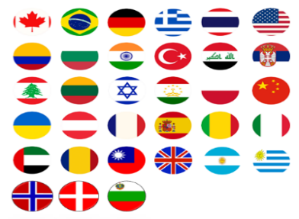









Internationalization, global presence with local reach to our customers
Offices in Europe GERMANY: Frankfurt, Mannheim, München, Karlsruhe, Berlin UK: London SPAIN: Zaragoza FRANCE: Paris BELGIUM: Saint-Georges, Mont-St-Guibert SWITZERLAND: Basel NORDIC REGION: Oslo, Copenhagen, Sønderborg BULGARIA: Sofia
Offices in North America USA: New Haven, Boston, Philadelphia Indianapolis, Washington D.C.
Offices in Asia CHINA: Shanghai INDIA: New Delhi
■ = PharmaLex Group
■ = RegNet Partner Network

Slide 5

PharmaLex Bulgaria, part of a global team of…
Medical doctors
Pharmacovigilance experts
Pharmacists
Preclinical doctors
Immunologists / toxicologists
Statisticians
Data entry personnel
Health economists & managers
Quality specialists
It experts
Business development manager

Slide 6



PharmaLex Bulgaria, services
Regulatory Affairs
Pharmacovigilance
Development Consulting & Scientific Affairs
Pharma company

Slide 7



PharmaLex Bulgaria, services
Pharmacovigilance
Global reach &
local presence
Regulatory affaires
Development consulting & Scientific affaires
Eudravigilance registration
Newly-adopted legislation implementation plan
PSMF
SOP
QPPV
Management of ICSRs / SUSARs
Creation / Maintenance of the XEVMPD drug list
LLR / GLR
Signal detection and analysis
  Signal management
PSUR
Audits
RMP
  Development Safety Update Report (DSUR)
  Company Core Safety Information (CCSI)
  Reference Safety Documents: CCDS, SPC, PIL
  SBR and AR
  General PV trainings and other tailor-made trainings
  Medical review and information
Application Services:
        Global procedure management (all types of initial applications and all maintenance activities)
        CCDS development and worldwide roll-out, labeling adaptations
CMC Services: CMC writing (Chemicals and Biologicals, pre- and post-marketing), Change control procedures (regulatory compliance)
Electronic submission services in all formats (QC-checks, eCTD-validation, gateway handling)
Strategic Outsourcing: Full maintenance of customers’ portfolios
On-site support Services (PLx employees supporting on the clients’ premises – Germany, Spain, others)
GMP, GACP and GDP audit and inspection support
Development strategy and gap analysis
Clinical trial designs
Health authority briefing documents
Scientific advice and health authority meetings
Due diligences
CTD clinical & nonclinical documents
Pediatric investigation plans / pediatric study plans
Orphan drug designations
Environmental risk assessment (EU, USA, Canada)
Clinical statistics covering method development, validation, transfer and stability testing and non-clinical statistics covering research, CMC and manufacturing

Slide 8
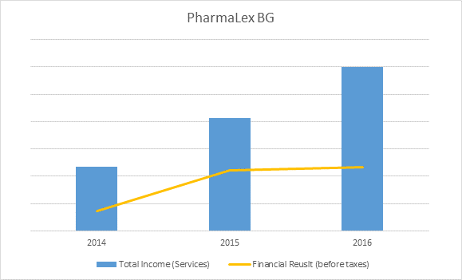
PharmaLex Bulgaria, trends of growth…
A positive trend of growth is kept during the first 3 years of existence of the company

Slide 9








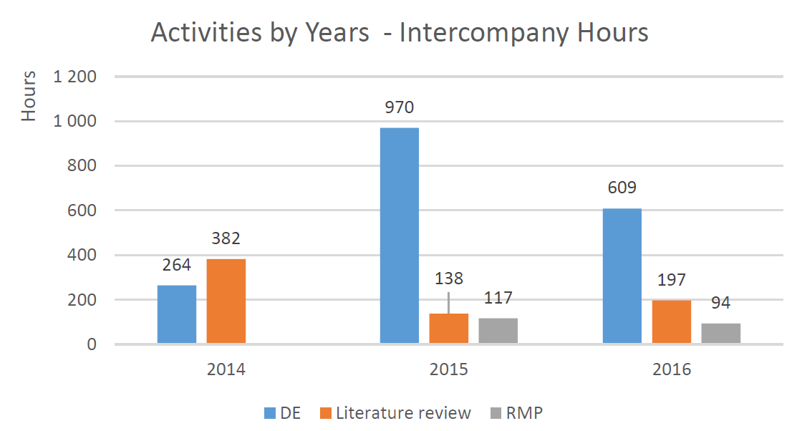
PharmaLex Bulgaria, market…
Local portfolio / among our most valuable & loyal clients…
Intercompany projects (NO, DK):

Slide 10
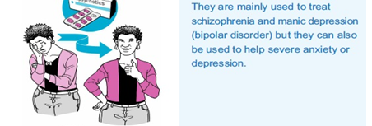
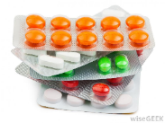
Drug safety for ALL (people with disabilities included)
Access to drug information for disabled people:
CONVENTION ON THE RIGHTS OF PERSONS WITH DISABILITIES:
…full realization of all human rights and fundamental freedoms for all persons with disabilities without discrimination of any kind on the basis of disability.
Access to information is recognized as a fundamental human right.
GUIDELINE ON THE READABILITY OF THE LABELLING AND PACKAGE LEAFLET OF MEDICINAL PRODUCTS FOR HUMAN USE
“The package leaflet shall reflect the results of consultations with target patient groups to ensure that it is legible, clear and easy to use.”
Do you have an idea how easy and legible is a patient leaflet for a person with cognitive impairments?
The only information for blind people provided on the outer packaging is the name of the medicine and its strength (Ex. Paracetamol 500mg).
How would a blind person know what is the expiry date?
The contraindications? If you have allergy or you didn’t read the contraindications you may find yourself in the hospital!
The reporting of adverse reactions terms? See next slide!
How a blind person will have access to the information from the leaflet? “For blind people the text has to be provided in an appropriate format, it is recommended to provide the text in a format perceptible by hearing
(CD-ROM, audiocassette, etc.). In certain cases the appropriate format may be the package leaflet available in Braille.”
How about audiocassette or CD-ROM nowadays?
Do you know which one of these will cure your stomachache?
How a blind person would know what’s the corresponding packaging, leaflet…?

Slide 11
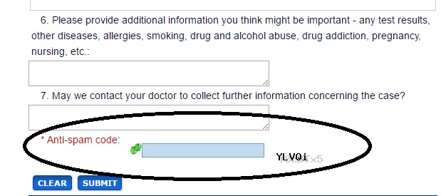
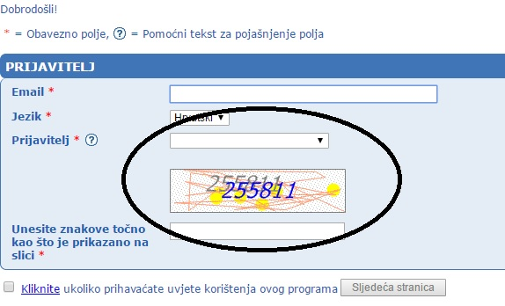
Drug safety for ALL (people with disabilities included)
Access to the adverse reactions on-line reporting tools for blind people:
If you think a medicine has caused you a side effect
You should check the package leaflet that comes with the medicine for information on how to report it to the authorities.
You should report the adverse reaction by filling in a form online
For more details, and to report online, please check the website of your national authority

Slide 12

Thank you for the attention!
Mrs. Albena Eftenova
Managing Director
+359-887-516-771
albena.eftenova@pharmalex.com
PharmaLex Bulgaria JSC
Str. Koziak 11
1407 Sofia
Bulgaria

